Slide 1

ePortfolio
Recommendations that set you on the right course.
Notes:
Suyash (10-15 seconds):
Hello everyone, we are team 5 and we are here to present ePortfolio. This is the solution to one of the most frustrating and annoying hurdle that all Yorku students have to cross every semester.

Slide 2
The problem
Course Enrollment

Slide 3
The problem
Academic Calendar
Find and parse required courses from technical jargon.
Mental mapping
Figure out pre-requisites and plan future courses accordingly.
Course directory
Go through an user-UNfriendly interface to figure out sections and professors.
Enroll in REM
Input the course number and repeat if there’s a mistake with pre-requisites
Notes:
Suyash (30-40 seconds):

Slide 4
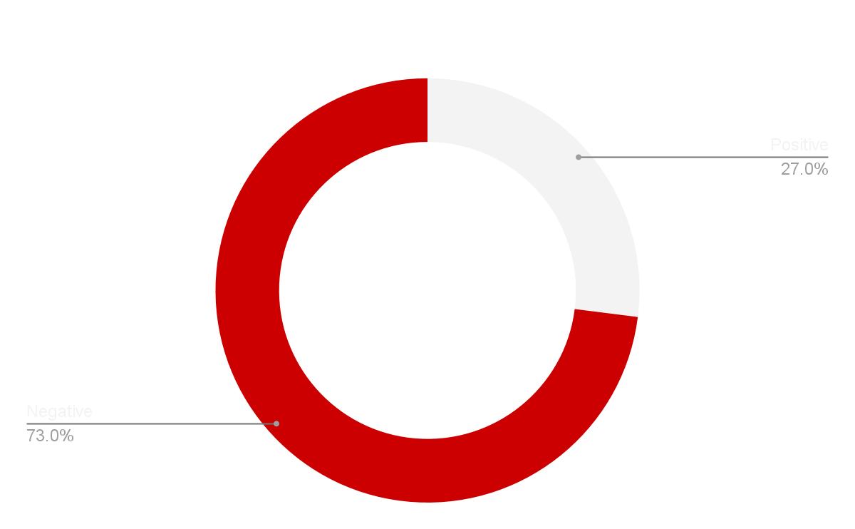
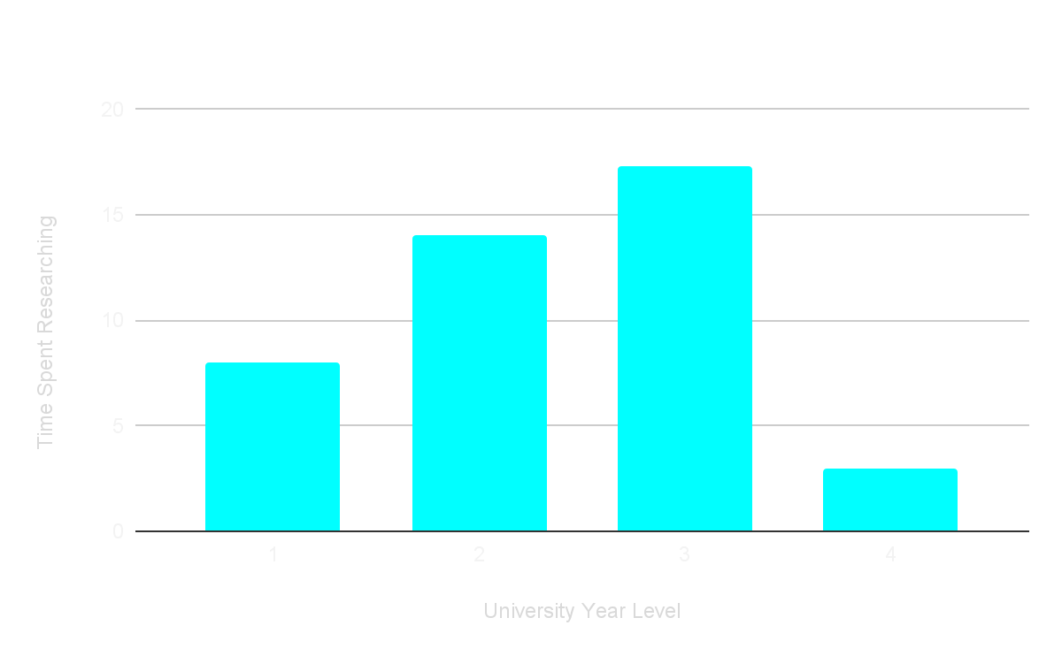
Survey Statistics
73% unhappy
12+ hours
with the overall experience
spent per semester in recon
Notes:
Anna(20-30 seconds): And thus based on survey statistics the problem truly shows itself. 73% of students who were surveyed said they were unhappy with how hard it was to navigate the Yorku websites. With many people reporting that they spent more than 12 hours per semester collecting information on which courses they were going to enroll into.

Slide 5
The Solution
Combine them into one platform
Mental mapping
Academic Calendar
Course Directory
ePortfolio
Notes:
Anna(20-30 seconds): The solution to that problem? ePortfolio. It will combine what students already do and fulfill all requests without fear of missing any information. It will replace the need to make a mental map every semester for all your courses, the need to check and recheck the academic calendar, and will integrate a huge course directory that will be constantly updated.

Slide 6
A.I Model
Experience
Market trends
Student portfolio
Personalized Course Recommendations
Interests
Aspirations
Notes:
Suyash (15-25 seconds): The AI model will take into account many factors, from personal things like aspirations to more quickly changing topics like market trends, to give you the most up to date and personalized course recommendations.

Slide 7
Demo
Notes:
Heet (70-80 seconds):
Explain the workings of the prototype.

Slide 8
Business Model
?
Demographic
York University students.
Key product
Personalized, highly accurate and fitting recommendations based on trends, and portfolio
Revenue
$5/Semester or Yorku Grants. Less than a coffee for a semester of reduced tension. Could depend on how university would like to market/proceed.
:
Notes:
Anna (25-30 seconds):
So, in an overview, our business revolves around data and that is our key product. We use our state of the art A.I. that crunches huge amounts of data to make these life altering recommendations.
We specifically target YorkU undergrads and graduates for now with plans for future expansion you will see in a minute.
Our revenue model is dynamic in nature and it depends on how much the university plans on supporting us for the betterment of student community.
We plan on charging $5 per semester which could go down if university adopts the platform wholeheartedly.

Slide 9
Future Goals
Expand the A.I. model to account for other faculties and universities
Extend the database to accommodate post graduates and PhD
Course teaching recommendations for professors
Improve the overall experience iteratively based on feedback
Notes:
Faiyaz (20-30 seconds):

Slide 10
Thank you for listening!

Slide 11
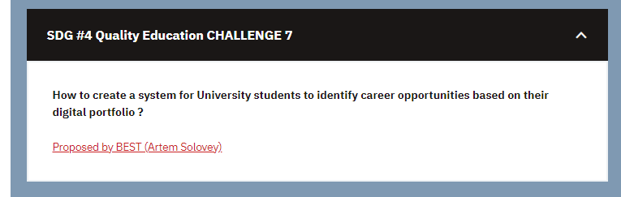
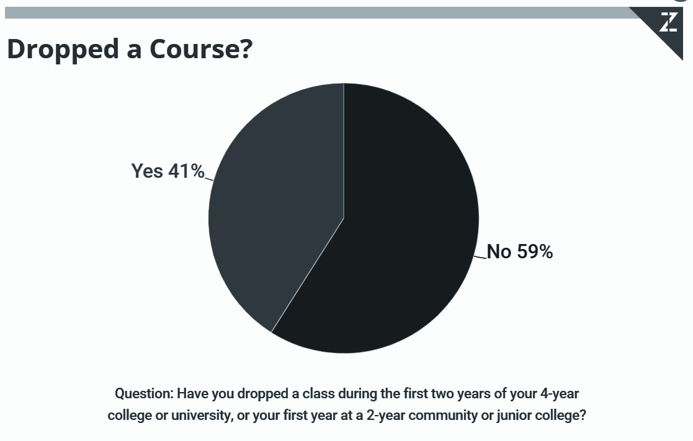
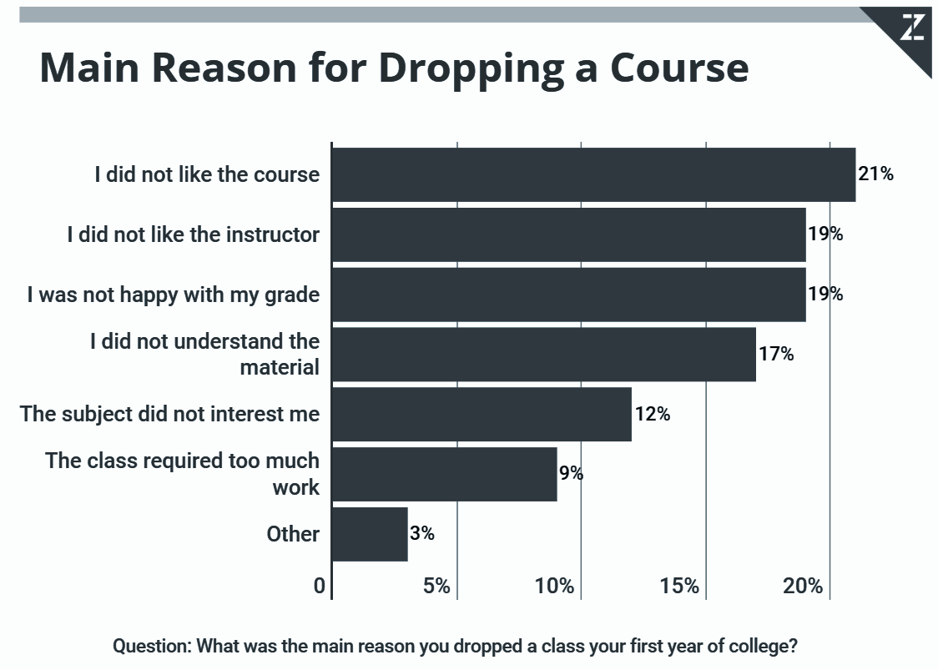
random info and resources(to be deleted)

